Slide 1



Uvangaujunga - Lesson 3
Acceptance

Slide 2
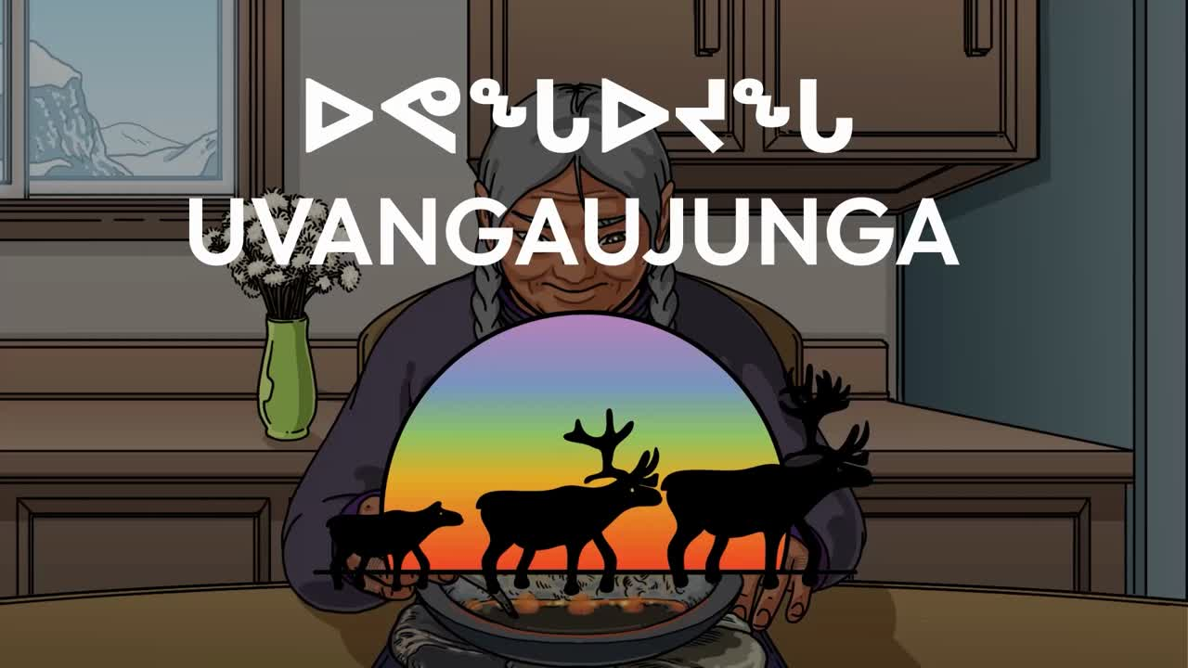

Slide 3

Learning goals
By the end of Lesson 3 participants can:
  Identify the overall impacts of homophobia.
  Identify 2 realistic actionable steps to make their community more inclusive.

Slide 4
Acceptance
  What did you think of this video? What were your first impressions?
  How does this video relate to issues people face in real life?

Slide 5
Final Activity
  Going back to our discussions from previous weeks, take some time to think about allyship.
  Imagine in an ideal world you have all the supports that you require. In this ideal world what are the supports in place in Nunavut?
  You can name specific resources that exist, in Canada, or in the world or even create a resource that would be helpful. What would these resources offer to Nunavummiut belonging to the 2SLGBTQI+ community?

Slide 6


Slide 7
  Lastly, coming back to reality, what would taking action towards inclusivity look like? In your school, in your community, even amongst your peers?

Slide 8
Closing
Thank you all for sharing your responses and participating in this discussion. We have supports available, so if you feel like you need to speak with someone, there are resources listed on the resource cards provided or you can speak with the support person present.

Slide 9
Territorial Supports
The mental health nurse in your community
Your local Ilinniarvimmi Inuusilirijiit (school community counsellors)
Wellness centres:
Kitikmeot—Department of Healthy Living: 867-943-4670
Kivalliq—Pulaarvik Kablu Friendship Centre: 867-645-2600
Qikiqtani—Ilisaqsivik: 867-924-6565
Iqaluit—Tukisigiarvik: 867-979-2400
Kamatsiaqtut Helpline:
Call 867-979-3333 or toll-free 1-800-265-3333
Healing by Talking:
Call 1-888-648-0070 or email healing@gov.nu.ca

Slide 10
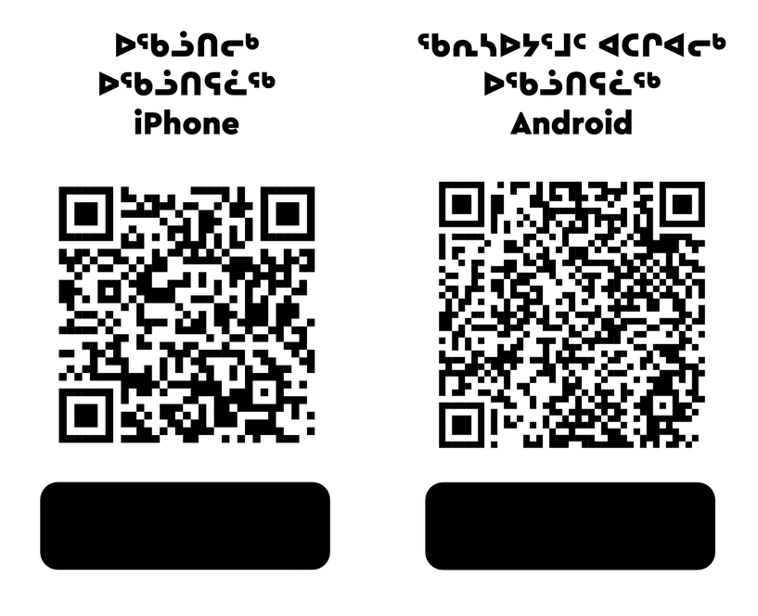
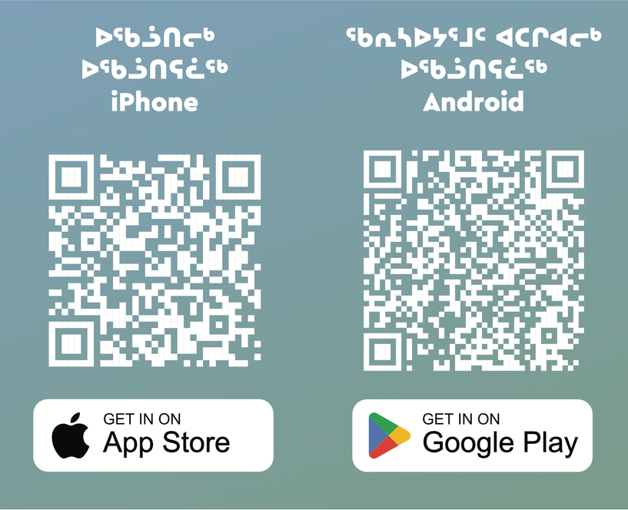
National Supports
Trans Lifeline:
Call 1-877-330-6366
LGBT Youth Line:
Call 1-800-268-9688 or text 647-694-4275 for youth up to age 29.
Kids Help Phone:
Use the online chat at kidshelpphone.ca
call 1-800-668-6868 or text CONNECT to 686868
Isumajunnattiarniq App

Slide 11

Visit egale.ca for more free resources, tools, and information
Visit Inuusiq.com for more information

Slide 12
Thank you! Nakurmiik!

