Slide 1



Uvangaujunga - Lesson 2
Allyship

Slide 2

Learning goals
By the end of Lesson 2 participants can:
  Define allyship and can identify at least 2 ways of being an ally.
  Explain stigma and its negative impacts.
  Explain the connection between one’s identity and their community.

Slide 3
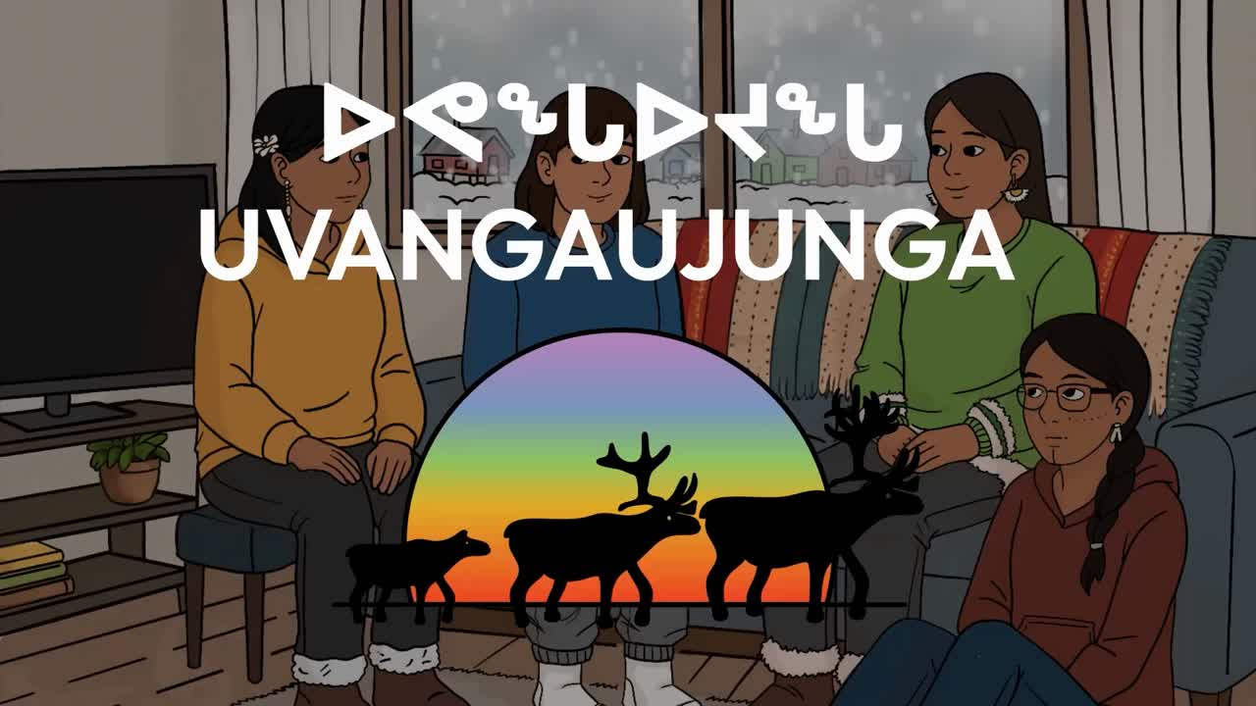

Slide 4
Allyship
  What stood out to you in this video?
  What are some feelings that came up as you watched the video?
  Seems like being bisexual is stigmatized…do you know what stigma means?

Slide 5
  Split into groups
  In the video, we noticed some positives, some of her classmates stood up for Neeve. In your daily life, what are some ways in which you can show that you are an ally? What does allyship mean to you?

Slide 6


Slide 7

Final Activity
The significance of 2 spirit individuals belonging to Indigenous communities and the impacts of colonization on them.

Slide 8
  Bringing back Allyship and the challenges that we had discussed in the last discussion, how can you apply allyship to address these challenges that are unique to queer people in Nunavut?
  Refer back to responses collected during lesson 1
  When we consider supports, how are identity and community connected, according to indigenous worldviews?

Slide 9
Closing
Thank you all for sharing your responses and participating in this discussion. We have supports available, so if you feel like you need to speak with someone, there are resources listed on the resource cards provided or you can speak with the support person present. We will continue this conversation in the next part.

Slide 10
Territorial Supports
The mental health nurse in your community
Your local Ilinniarvimmi Inuusilirijiit (school community counsellors)
Wellness centres:
Kitikmeot—Department of Healthy Living: 867-943-4670
Kivalliq—Pulaarvik Kablu Friendship Centre: 867-645-2600
Qikiqtani—Ilisaqsivik: 867-924-6565
Iqaluit—Tukisigiarvik: 867-979-2400
Kamatsiaqtut Helpline:
Call 867-979-3333 or toll-free 1-800-265-3333
Healing by Talking:
Call 1-888-648-0070 or email healing@gov.nu.ca

Slide 11
National Supports
Trans Lifeline:
Call 1-877-330-6366
LGBT Youth Line:
Call 1-800-268-9688 or text 647-694-4275 for youth up to age 29.
Kids Help Phone:
Use the online chat at kidshelpphone.ca
call 1-800-668-6868 or text CONNECT to 686868

Slide 12

Visit egale.ca for more free resources, tools, and information
Visit Inuusiq.com for more information

Slide 13
Thank you! Nakurmiik!

