Slide 1



Uvangaujunga - Lesson 1
Accountability

Slide 2

Learning goals
By the end of Lesson 1 participants can:
  Identify and define at least 4 terms from the 2SLGBTQI+ acronym.
  Explain what a microaggression is and can provide examples.
  Name at least 2 sources of support.

Slide 3

Terminology you must know
https://www.youtube.com/watch?v=tRvFj3ugdWU

Slide 4
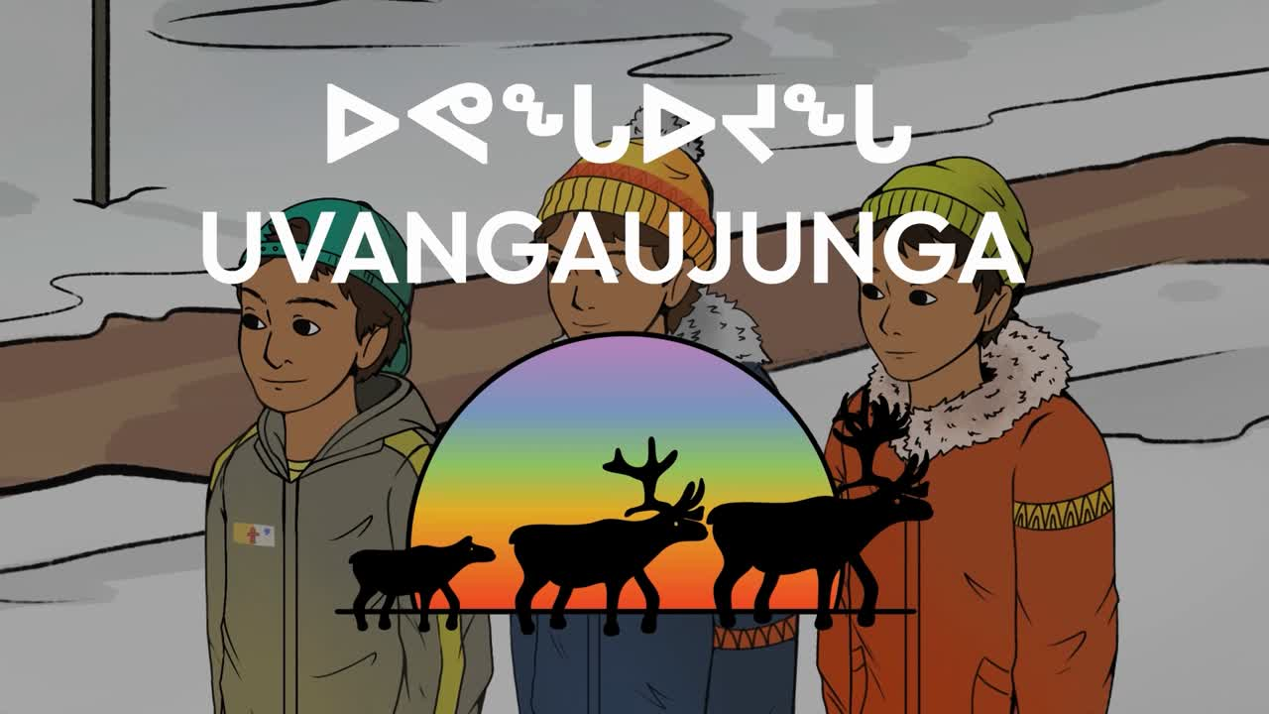

Slide 5
Accountability
  What stood out to you in this video?
  What type of language was used in this video?
  Did you have moments where you were uncomfortable or surprised?

Slide 6
Themes that will appear during this discussion
  Homophobia
  Micro-aggression
  Name calling
  Peer pressure

Slide 7
Accountability
  Why do you think such (homophobic) jokes are common?

Slide 8


Slide 9
History of Pride
https://www.youtube.com/watch?v=Q1D65SxzojI

Slide 10
History of Pride
  Play video: https://www.youtube.com/watch?v=Q1D65SxzojI
  What is homophobia?
  Do you know what microaggressions are?
  How does youth 3 speak-up against youth 1?
  In an alternate version, where no one speaks up, what might happen?

Slide 11
Final Activity
  What do you think would be some unique challenges of being a part of the 2SLGBTQI+ community in Nunavut?
  Write down your answers on the pieces of paper provided. Your responses will be discussed in the next lesson.

Slide 12
Closing
Thank you all for sharing your responses and participating in this discussion. We have supports available, so if you feel like you need to speak with someone, there are resources listed on the resource cards provided or you can speak with the support person present.
We will continue this conversation in the next part, where we will discuss how we can address these unique challenges.

Slide 13
Territorial Supports
The mental health nurse in your community
Your local Ilinniarvimmi Inuusilirijiit (school community counsellors)
Wellness centres:
Kitikmeot—Department of Healthy Living: 867-943-4670
Kivalliq—Pulaarvik Kablu Friendship Centre: 867-645-2600
Qikiqtani—Ilisaqsivik: 867-924-6565
Iqaluit—Tukisigiarvik: 867-979-2400
Kamatsiaqtut Helpline:
Call 867-979-3333 or toll-free 1-800-265-3333
Healing by Talking:
Call 1-888-648-0070 or email healing@gov.nu.ca

Slide 14
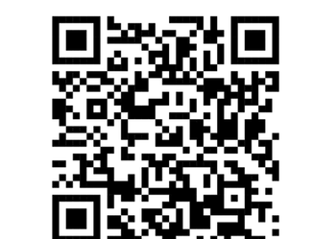
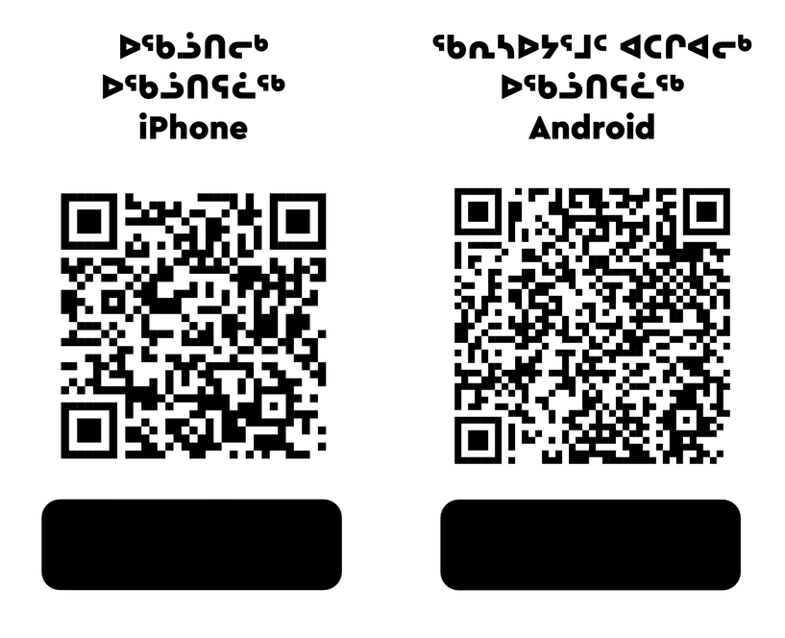
National Supports
Trans Lifeline:
Call 1-877-330-6366
LGBT Youth Line:
Call 1-800-268-9688 or text 647-694-4275 for youth up to age 29.
Kids Help Phone:
Use the online chat at kidshelpphone.ca
call 1-800-668-6868 or text CONNECT to 686868
Isumajunnattiarniq App
iphone
android

Slide 15

Visit egale.ca for more free resources, tools, and information
Visit Inuusiq.com for more information

