Slide 1



Uvangaujunga - Lesson 1
Accountability

Slide 2

Learning goals
By the end of Lesson 1 participants can:
  Identify and define at least 4 terms from the 2SLGBTQI+ acronym.
  Explain what a microaggression is and can provide examples.
  Name at least 2 sources of support.

Slide 3

Terminology you must know
https://www.youtube.com/watch?v=tRvFj3ugdWU

Slide 4
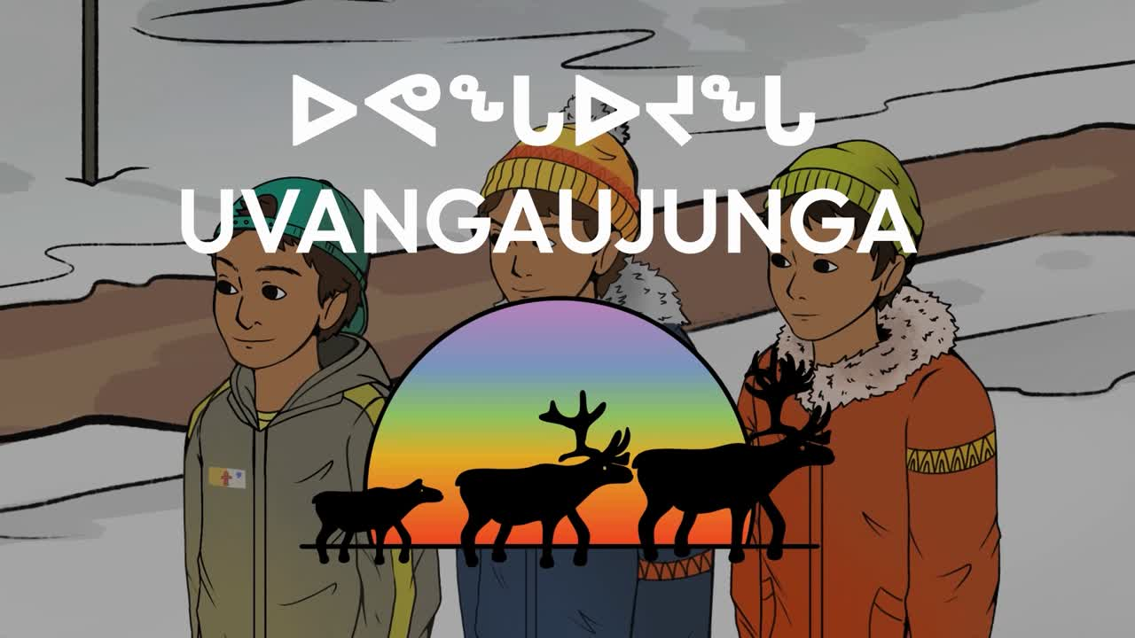

Slide 5
Accountability
  What stood out to you in this video?
  What type of language was used in this video?
  Did you have moments where you were uncomfortable or surprised?

Slide 6
Themes that will appear during this discussion
  Homophobia
  Micro-aggression
  Name calling
  Peer pressure

Slide 7
Accountability
  Why do you think such (homophobic) jokes are common?

Slide 8


Slide 9
History of Pride
https://www.youtube.com/watch?v=Q1D65SxzojI

Slide 10
History of Pride
  Play video: https://www.youtube.com/watch?v=Q1D65SxzojI
  What is homophobia?
  Do you know what microaggressions are?
  How does youth 3 speak-up against youth 1?
  In an alternate version, where no one speaks up, what might happen?

Slide 11
Final Activity
  What do you think would be some unique challenges of being a part of the 2SLGBTQI+ community in Nunavut?
  Write down your answers on the pieces of paper provided. Your responses will be discussed in the next lesson.

Slide 12
Closing
Thank you all for sharing your responses and participating in this discussion. We have supports available, so if you feel like you need to speak with someone, there are resources listed on the resource cards provided or you can speak with the support person present.
We will continue this conversation in the next part, where we will discuss how we can address these unique challenges.

Slide 13
Territorial Supports
The mental health nurse in your community
Your local Ilinniarvimmi Inuusilirijiit (school community counsellors)
Wellness centres:
Kitikmeot—Department of Healthy Living: 867-943-4670
Kivalliq—Pulaarvik Kablu Friendship Centre: 867-645-2600
Qikiqtani—Ilisaqsivik: 867-924-6565
Iqaluit—Tukisigiarvik: 867-979-2400
Kamatsiaqtut Helpline:
Call 867-979-3333 or toll-free 1-800-265-3333
Healing by Talking:
Call 1-888-648-0070 or email healing@gov.nu.ca

Slide 14
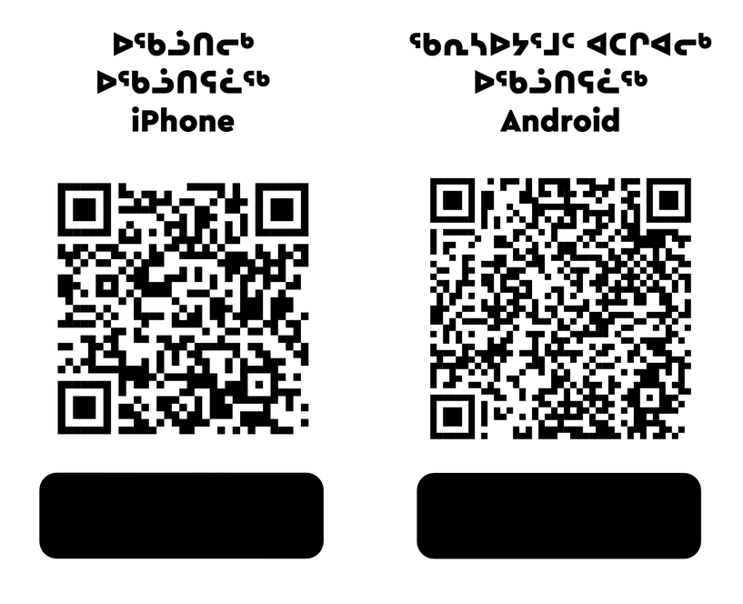
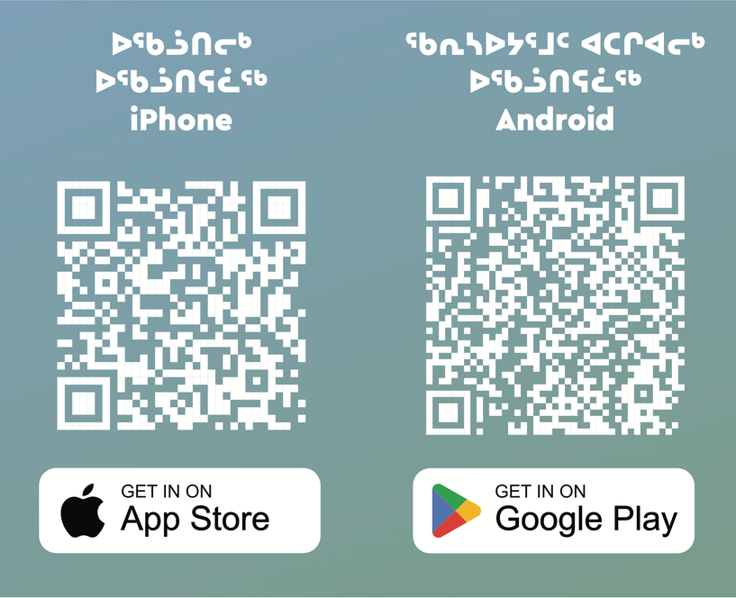
National Supports
Trans Lifeline:
Call 1-877-330-6366
LGBT Youth Line:
Call 1-800-268-9688 or text 647-694-4275 for youth up to age 29.
Kids Help Phone:
Use the online chat at kidshelpphone.ca
call 1-800-668-6868 or text CONNECT to 686868
Isumajunnattiarniq App

Slide 15

Visit egale.ca for more free resources, tools, and information
Visit Inuusiq.com for more information

Slide 16
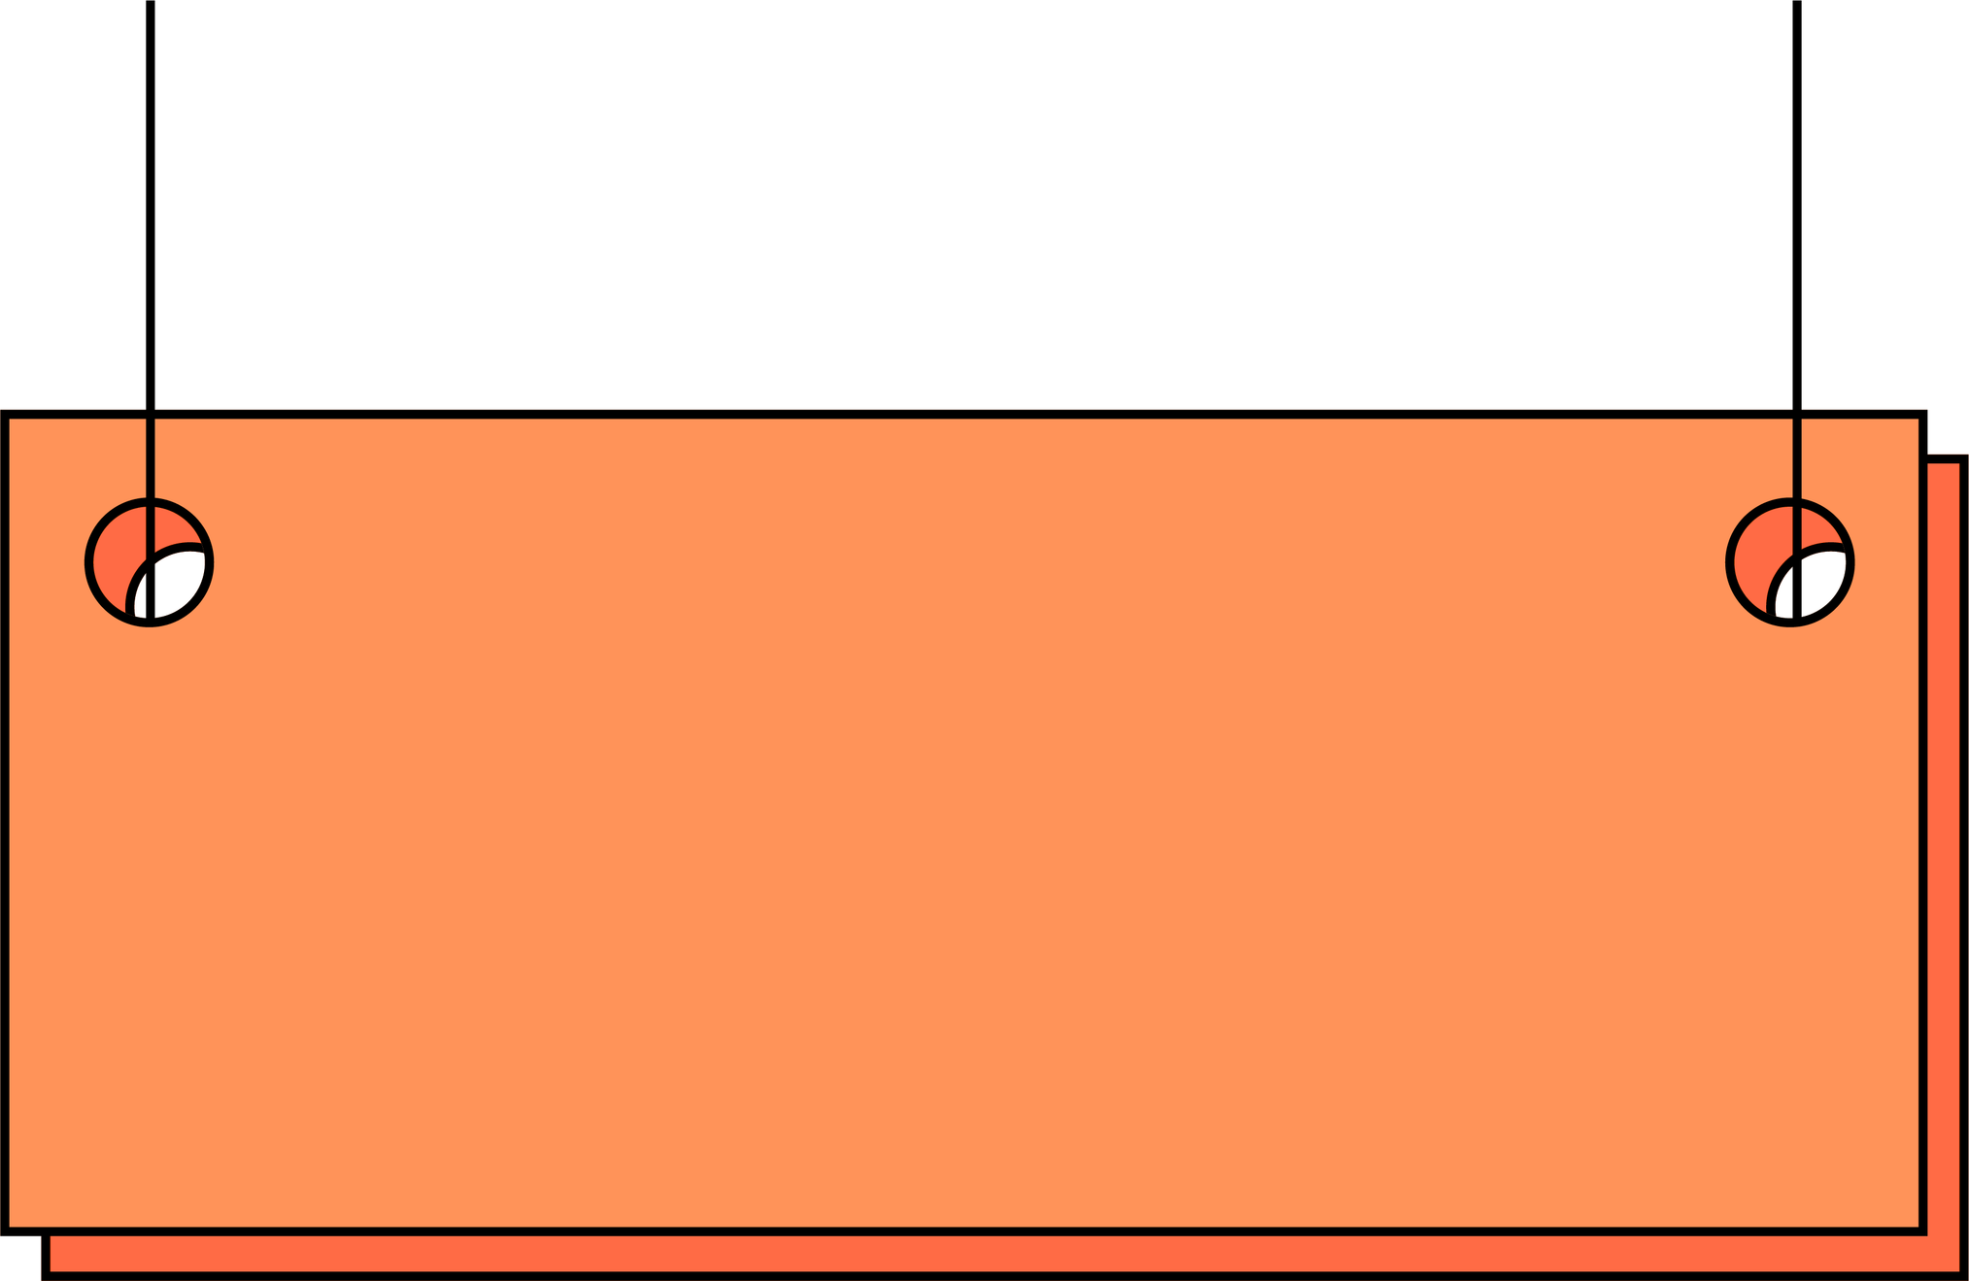
Uvangaujunga - Lesson 2
Allyship

Slide 17
Learning goals
By the end of Lesson 2 participants can:
  Define allyship and can identify at least 2 ways of being an ally.
  Explain stigma and its negative impacts.
  Explain the connection between one’s identity and their community.

Slide 18
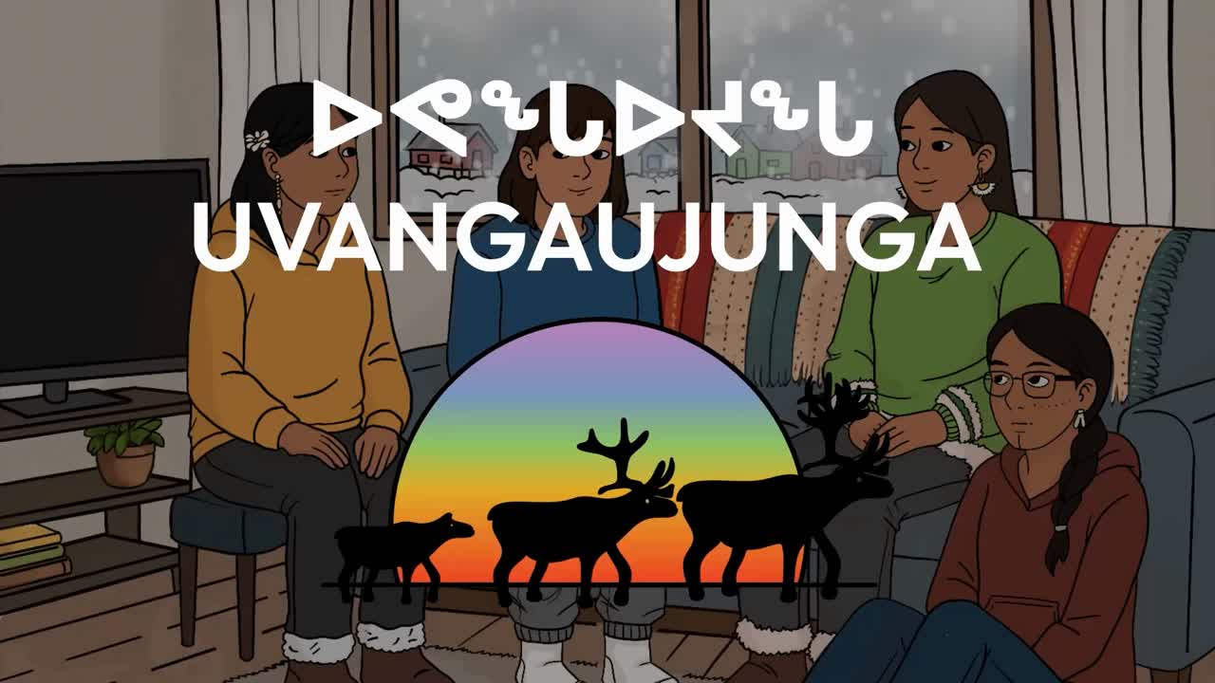

Slide 19
Allyship
  What stood out to you in this video?
  What are some feelings that came up as you watched the video?
  Seems like being bisexual is stigmatized…do you know what stigma means?

Slide 20
  Split into groups
  In the video, we noticed some positives, some of her classmates stood up for Neeve. In your daily life, what are some ways in which you can show that you are an ally? What does allyship mean to you?

Slide 22
Final Activity
The significance of 2 spirit individuals belonging to Indigenous communities and the impacts of colonization on them.

Slide 23
  Bringing back Allyship and the challenges that we had discussed in the last discussion, how can you apply allyship to address these challenges that are unique to queer people in Nunavut?
  Refer back to responses collected during lesson 1
  When we consider supports, how are identity and community connected, according to indigenous worldviews?

Slide 24
Closing
Thank you all for sharing your responses and participating in this discussion. We have supports available, so if you feel like you need to speak with someone, there are resources listed on the resource cards provided or you can speak with the support person present. We will continue this conversation in the next part.

Slide 25
Territorial Supports
The mental health nurse in your community
Your local Ilinniarvimmi Inuusilirijiit (school community counsellors)
Wellness centres:
Kitikmeot—Department of Healthy Living: 867-943-4670
Kivalliq—Pulaarvik Kablu Friendship Centre: 867-645-2600
Qikiqtani—Ilisaqsivik: 867-924-6565
Iqaluit—Tukisigiarvik: 867-979-2400
Kamatsiaqtut Helpline:
Call 867-979-3333 or toll-free 1-800-265-3333
Healing by Talking:
Call 1-888-648-0070 or email healing@gov.nu.ca

Slide 26
National Supports
Trans Lifeline:
Call 1-877-330-6366
LGBT Youth Line:
Call 1-800-268-9688 or text 647-694-4275 for youth up to age 29.
Kids Help Phone:
Use the online chat at kidshelpphone.ca
call 1-800-668-6868 or text CONNECT to 686868
Isumajunnattiarniq App

Slide 27
Visit egale.ca for more free resources, tools, and information
Visit Inuusiq.com for more information

Slide 28
Uvangaujunga - Lesson 3
Acceptance

Slide 29
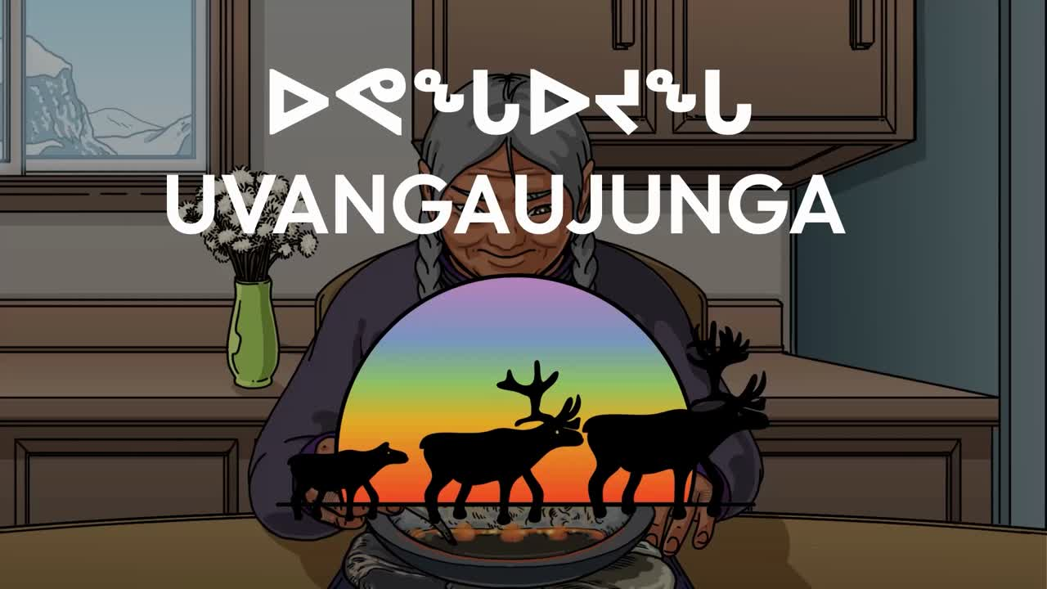

Slide 30
Learning goals
By the end of Lesson 3 participants can:
  Identify the overall impacts of homophobia.
  Identify 2 realistic actionable steps to make their community more inclusive.

Slide 31
Acceptance
  What did you think of this video? What were your first impressions?
  How does this video relate to issues people face in real life?

Slide 32
Final Activity
  Going back to our discussions from previous weeks, take some time to think about allyship.
  Imagine in an ideal world you have all the supports that you require. In this ideal world what are the supports in place in Nunavut?
  You can name specific resources that exist, in Canada, or in the world or even create a resource that would be helpful. What would these resources offer to Nunavummiut belonging to the 2SLGBTQI+ community?

Slide 34
  Lastly, coming back to reality, what would taking action towards inclusivity look like? In your school, in your community, even amongst your peers?

Slide 35
Closing
Thank you all for sharing your responses and participating in this discussion. We have supports available, so if you feel like you need to speak with someone, there are resources listed on the resource cards provided or you can speak with the support person present.

Slide 36
Territorial Supports
The mental health nurse in your community
Your local Ilinniarvimmi Inuusilirijiit (school community counsellors)
Wellness centres:
Kitikmeot—Department of Healthy Living: 867-943-4670
Kivalliq—Pulaarvik Kablu Friendship Centre: 867-645-2600
Qikiqtani—Ilisaqsivik: 867-924-6565
Iqaluit—Tukisigiarvik: 867-979-2400
Kamatsiaqtut Helpline:
Call 867-979-3333 or toll-free 1-800-265-3333
Healing by Talking:
Call 1-888-648-0070 or email healing@gov.nu.ca

Slide 37
National Supports
Trans Lifeline:
Call 1-877-330-6366
LGBT Youth Line:
Call 1-800-268-9688 or text 647-694-4275 for youth up to age 29.
Kids Help Phone:
Use the online chat at kidshelpphone.ca
call 1-800-668-6868 or text CONNECT to 686868
Isumajunnattiarniq App

Slide 38
Visit egale.ca for more free resources, tools, and information
Visit Inuusiq.com for more information

Slide 39
Thank you! Nakurmiik!

